Slide 1
Homework Assignment #2
Chat Room Programming

Slide 2
Outline
Socket
Socket API
Thread
Select()
Homework Assignment #2

Slide 3
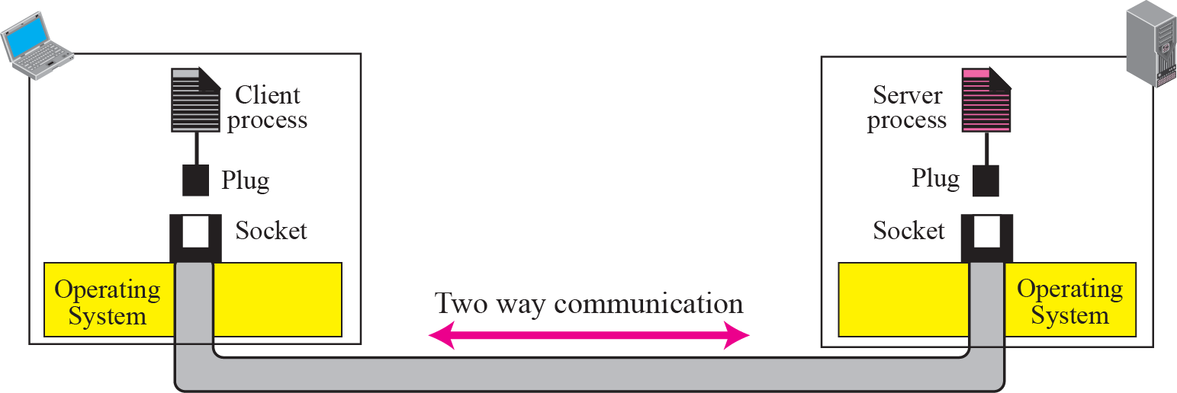
Socket
It was first developed at the University of California, Berkeley for use on Unix systems
  Berkeley socket
All modern operating systems now have some implementation of the Berkeley socket interface
  Became the standard interface for connecting to the Internet
To allow communications between hosts or between processes on one computer
Concepts of sockets

Slide 4
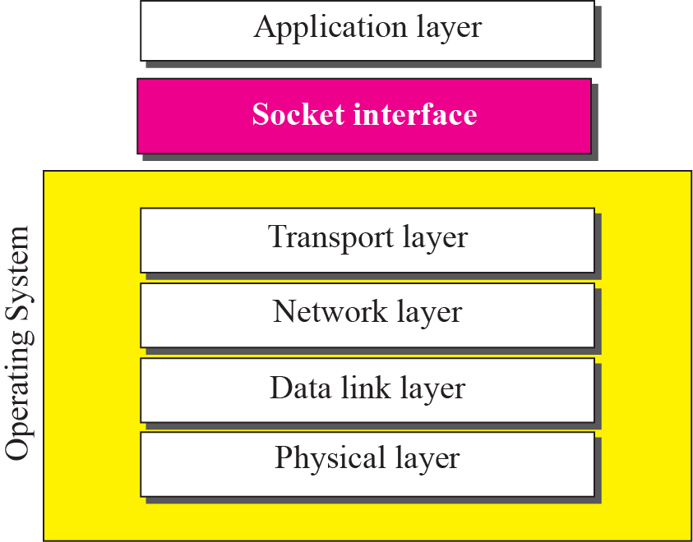
Socket(cont.)
Relation between the operating system and the TCP/IP suite

Slide 5
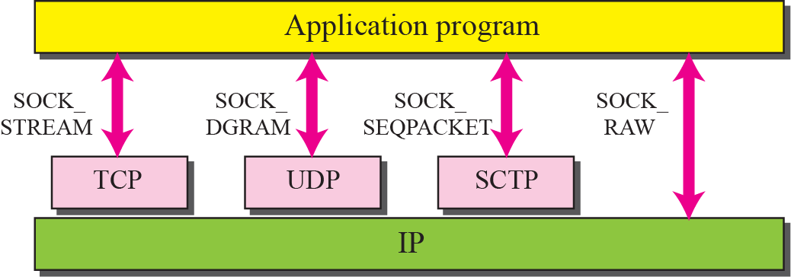
Socket(cont.)
Socket types

Slide 6
Outline
Socket
Socket API
Thread
Select()
Homework Assignment #2

Slide 7


Socket API
socket()
socket()
bind()
listen()
connect()
Three-Way Handshake
accept()
send()
recv()
recv()
send()
close()
EOF
recv()

Slide 8
Socket API (cont.)
socket
  Create a descriptor for use in network communication
#include <sys/type.h>
#include <sys/socket.h>
int socket(int domain, int type, int protocol);
EX: sock = socket(PF_INET, SOCK_STREAM, 0);
domain:
PF_UNIX: Protocol Family is UNIX
(for local communication)
PF_INET: Protocol Family is IPv4
PF_INET6:Protocol Family is IPv6
type:
SOCK_STREAM: TCP
SOCK_DGRAM: UDP
SOCK_SEQPACKET: SCTP
SOCK_RAW
protocol:
0 ~ 255
  (ref. /etc/protocols. The value 0 may be used to select a default protocol from the selected domain and type)
return value:
successful:
    return a non-negative integer, socket descriptor (sd)
otherwise return -1

Slide 9
Socket API (cont.)
htons
  Convert the unsigned short integer hostshort from host byte order to network byte order
htonl
  Convert the unsigned integer hostlong from host byte order to network byte order
#include <arpa/inet.h>
uint16_t htons(uint16_t hostshort);
EX: address.sin_port = htons(5555);
#include <arpa/inet.h>
uint32_t htonl(uint32_t hostlong);
EX: address.sin_addr.s_addr = htonl(0x7F000001);

Slide 10
Socket API (cont.)
bzero
  Set the first n bytes of the area starting at s to zero (bytes containing '\0')
inet_addr
  Convert the Internet host address cp from IPv4 numbers-and-dots notation into binary data in network byte order
#include <string.h>
void bzero(char *s, int n);
EX: bzero(&Address, sizeof(Address));
#include <sys/socket.h>
#include <netinet/in.h>
#include <arpa/inet.h>
in_addr_t inet_addr(const char *cp);
EX: address.sin_addr.s_addr = inet_addr(“140.120.15.242”);

Slide 11
Socket API (cont.)
bind
  Bind a local IP address and protocol port to a socket
#include <sys/socket.h>
#include <netinet/in.h>
int bind(int sd, struct sockaddr *address, int address_length);
EX:
struct sockaddr_in Address;
bind(sock,(struct sockaddr *)&Address, sizeof(Address))

Slide 12
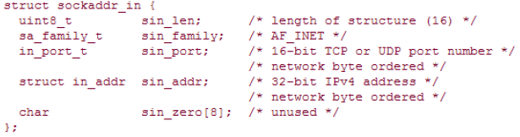
Socket API (cont.)
IPv4 Socket Address Structure
  Each supported protocol suite defines its own socket address structure
  The names of these structures begin with sockaddr_ and end with a unique suffix for each protocol suite
  An IPv4 socket address structure, commonly called an "Internet socket address structure," is named sockaddr_in and is defined by including the <netinet/in.h> header

Slide 13


Socket API (cont.)
Generic Socket Address Structure - Sockaddr
  Define a generic socket address structure in the <sys/socket.h> header
  This requires that any calls to these functions must cast the pointer to the protocol-specific socket address structure to be a pointer to a generic socket address structure
  For example,

Slide 14
Socket API (cont.)
listen
  Is used by a server to convert an unconnected socket into a passive socket
#include <sys/socket.h>
int listen(int socket_descriptor, int backlog);
EX: listen( sock, 20);
backlog:
It specifies the maximum number of connections the kernel
should queue for this socket

Slide 15
Socket API (cont.)
accept
  Is called by a TCP server to return the next completed connection from the front of the completed connection queue
connect
  Is used by a client to establish a connection with a server via a 3-way handshake
#include <sys/socket.h>
int accept(int socket_descriptor, struct sockaddr* addr, int* addrlen);
EX: recfd = accept ( sock, (struct sockaddr *)&client_addr, &client_addr_length );
#include <sys/socket.h>
int connect(int socket_descriptor, const struct sockaddr* addr, int addrlen);
EX: connect ( sock, (struct sockaddr *)&server_addr, server_addr_length );

Slide 16
Socket API (cont.)
recv
  Receive data on a socket
send
  Send data out over a socket
#include <sys/socket.h>
int recv(int socket_descriptor, char* buf, int len, int flags);
EX: byte_recv = recv(recvfd, buffer, sizeof(buffer), 0);
#include <sys/socket.h>
int send(int socket_descriptor, const char* buf, int len, int flags);
EX: byte_sent = send(sock, buffer, sizeof(buffer), 0);

Slide 17
Socket API (cont.)
close
  Terminate communication and deallocate a descriptor
#include <unistd.h>
int close(int sd);
EX: close(sock);

Slide 18
Socket Example
Using TCP - Client
#include <stdio.h>
#include <stdlib.h>
#include <string.h> //for bzero()
#include <unistd.h> //for close()
#include <sys/types.h>
#include <sys/socket.h>
#include <netinet/in.h>
#define Server_PortNumber 5555
#define Server_Address "140.120.15.242"
int main(int argc, char *argv[]) {
struct sockaddr_in server_addr;
int sock, byte_sent, server_addr_length = sizeof(server_addr);
char buffer[6]="hello\0";

Slide 19
Socket Example (cont.)
Using TCP – Client
sock = socket(PF_INET, SOCK_STREAM, 0);
if (sock < 0) printf("Error creating socket!\n");
bzero(&server_addr, server_addr_length);
server_addr.sin_family = AF_INET;
server_addr.sin_port = htons(Server_PortNumber);
server_addr.sin_addr.s_addr = inet_addr(Server_Address);
if (connect(sock, (struct sockaddr *)&server_addr,server_addr_length)==-1) {
printf("connect failed!");
close(sock);}
byte_sent = send(sock, buffer, sizeof(buffer),0);
if (byte_sent < 0) printf("Error sending packet!\n");
close(sock);
return 0;}

Slide 20
Socket Example (cont.)
Using TCP - Server
#include <stdio.h>
#include <stdlib.h>
#include <string.h> //for bzero()
#include <unistd.h> //for close()
#include <sys/types.h>
#include <sys/socket.h>
#include <netinet/in.h>
#define PortNumber 5555
int main(int argc, char *argv[]) {
struct sockaddr_in server_addr,client_addr;
int sock, byte_recv, server_addr_length = sizeof(server_addr), client_addr_length=sizeof(client_addr), recfd;
char buffer[50];
sock = socket(PF_INET, SOCK_STREAM, 0);
if (sock < 0) printf("Error creating socket\n");

Slide 21
Socket Example (cont.)
Using TCP - Server
bzero(&server_addr, server_addr_length);
server_addr.sin_family = AF_INET;
server_addr.sin_port = htons(PortNumber);
server_addr.sin_addr.s_addr = INADDR_ANY;
/*#define INADDR_ANY ((unsigned long int) 0x00000000)
INADDR_ANY allows the server to accept a client connection on any interface, in case the server host has multiple interfaces.*/
if (bind(sock,(struct sockaddr *)&server_addr, server_addr_length) == -1) {
printf("error binding!\n");
close(sock);}
if (listen(sock, 20) == -1) {
printf("listen failed!\n");
close(sock);}

Slide 22
Socket Example (cont.)
Using TCP - Server
if((recfd = accept(sock,(struct sockaddr *)&client_addr,&client_addr_length))==-1) {
printf("accept failed!\n");
close(sock);}
byte_recv = recv(recfd, buffer, sizeof(buffer),0);
if (byte_recv < 0) printf("Error recving packet\n");
printf("data: %s\n",buffer);
}

Slide 23
Outline
Socket
Socket API
Thread
Select()
Homework Assignment #2

Slide 24



message

Slide 25
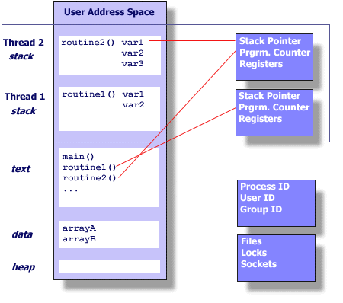
THREAD

Slide 26
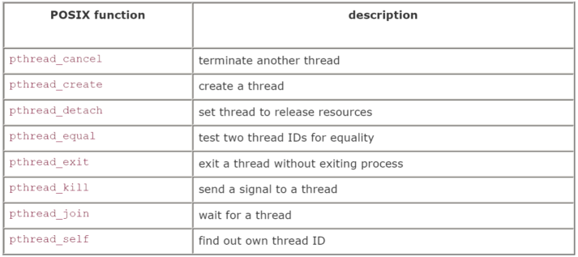
The Pthreads API
There is a whole set of library calls associated with threads, most of whose names start with pthread_
To use these library calls, we must include the file pthread.h, and link with the pthread library using -pthread

Slide 27
The Pthreads API (cont.)
pthread_create
  creates a thread
#include<pthread.h>
int pthread_create(pthread_t *thread, const pthread_att_t *attr,
void *(*start_routine)(void *), void *arg);
EX: pthread_create(&thread,NULL,PrintHello,(void*)t);
thread: Points to the ID of the newly created thread.
attr: An attribute object that encapsulates the attributes of a thread.
NULL for the default values.
start_routine: The C routine that the thread calls when it begins execution
arg: The argument that is to be passed to start_routine. NULL may be used if no argument is to be passed.

Slide 28
The Pthreads API (cont.)
pthread_join
  causes the caller to wait for the specified thread to exit
#include<pthread.h>
int pthread_join(pthread_t thread, void **value_ptr);
EX: pthread_join(thread,NULL);
thread: The ID of the terminating thread.
value_ptr: Provides a location for a pointer to the return status that the target thread passes to pthread_exit. NULL is used if the caller does not retrieve the target thread return status.
.

Slide 29
The Pthreads API (cont.)
pthread_exit
  terminates the calling thread
#include<pthread.h>
int pthread_exit(void *value_ptr);
EX: pthread_exit(NULL);
value_ptr: makes the value value_ptr available to any successful join with the terminating thread
We can use pthread_exit(NULL)to terminate a thread.

Slide 30
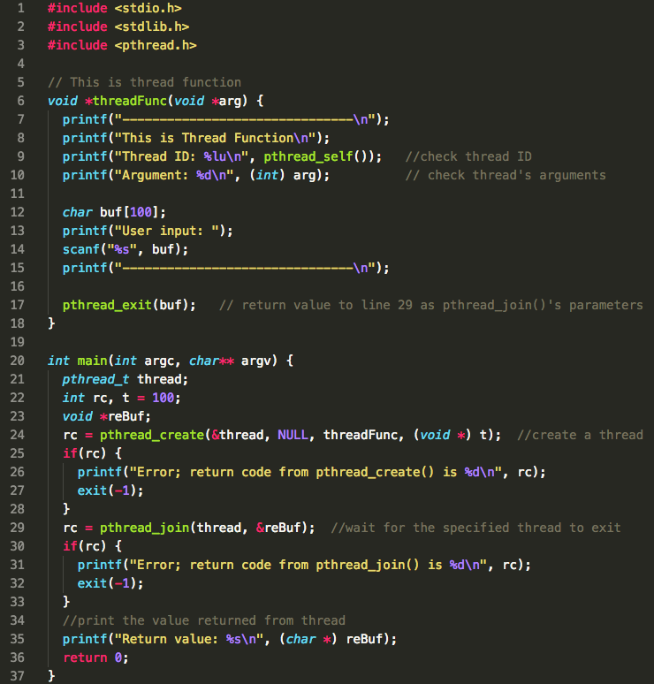
Thread Example

Slide 31
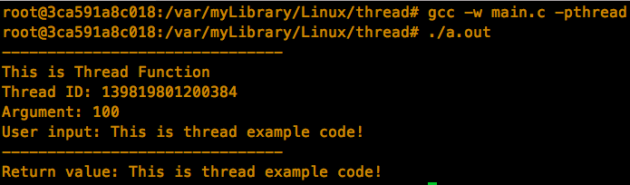
Thread Example (cont.)
While making pthread program, ensure to add “-pthread” option to command line. (Link libpthread.a library)

Slide 32
Outline
Socket
Socket API
Thread
Select()
Homework Assignment #2

Slide 33
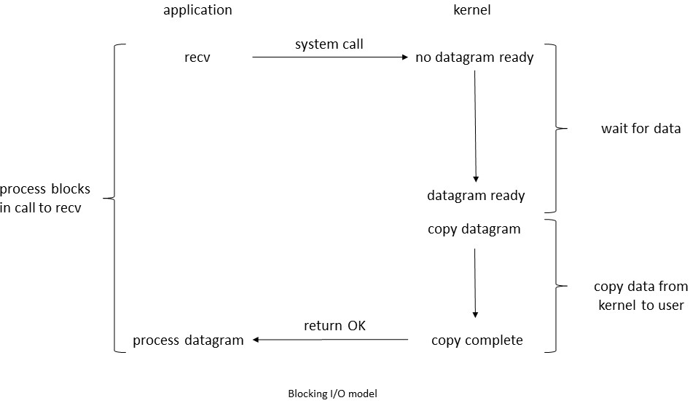
Blocking I/O vs Multiplexing I/O

Slide 34
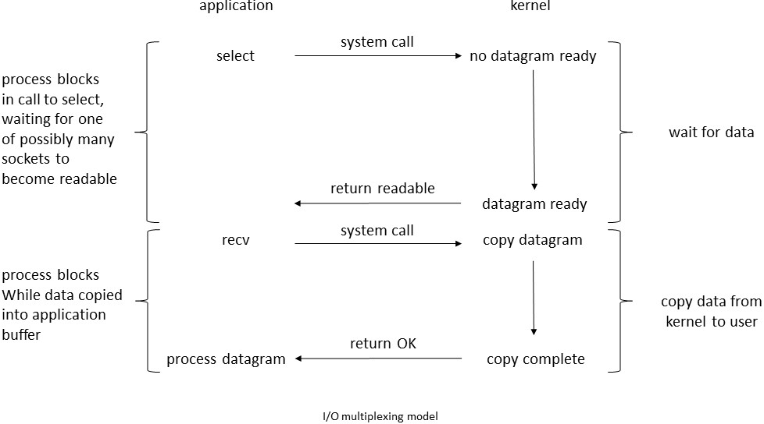
Blocking I/O vs Multiplexing I/O (Cont.)

Slide 35
The Select() System Call
select() function
  The select() function lets us do I/O multiplexing under all POSIX-compatible platforms.
  select() allows the process to instruct the kernel to wait for any one of multiple events to occur and wake up the process
    When one or more of these events occurs
    When a specified amount of time has passed

Slide 36
The Select() System Call (cont.)
  We use select() to tell kernel
    Which fd and what condition of that fd we are interested in
    How long we want to wait.
  On the return from select()
    The total count of the number of ready descriptors.
      Ready means you can do I/O now without blocking
    select() will check the descriptors that we are interested in :
      If it is ready , the bit is “1”.

Slide 37
The Select() System Call (cont.)
#include<sys/select.h>
#include<sys/time.h>
int select(int maxfdp1, fd_set * readfds, fd_set * writefds, fd_set * exceptfds, struct timeval * tvptr);
EX: select(int maxfdp1, &readfds, &writefds, NULL, NULL);
Maxfdp1 | Max file descriptor plus 1 /*fd_set[k] starts from 0*/
readfds writefds exceptfds | Three fd_sets contains the status of each file descriptor, you can use NULL as input.
tvptr | struct timeval{ long tv_sec; // seconds long tv_usec; // and microseconds } /*In Linux, you must initialize timeval{} ,and each time select() called will reset timeval{}
Return value | -1: Failure, 0: Timeout, >1: Ready to operate

Slide 38
The Select() System Call (cont.)
The readfds, writefds, and exceptfds are pointers to file descriptor sets, represented using the data type fd_set.
  maxfdp1 specify the file descriptors that select() is to monitor.
  readfds is the set of file descriptors to be tested to see if input is possible;
  writefds is the set of file descriptors to be tested to see if output is possible;
  exceptfds is the set of file descriptors to be tested to see if an exceptional condition has occurred
  timeout specifies an upper limit on the time for which select() is to wait

Slide 39
Supported Macros for select()
void FD_ZERO(fd_set * fdset); //clear all bits in fdset
EX: FD_ZERO (&readfds);
void FD_SET(int fd, fd_set * fdset); //turn on the bit for fd in fdset
EX: FD_SET (sd, &readfds);
void FD_CLR(int fd, fd_set * fdset); //turn off the bit for fd in fdset
EX: FD_CLR (sd, &readfds);
int FD_ISSET(int fd, fd_set * fdset); //is the bit for fd on in fdset?
EX: if( FD_ISSET(sd, &readfds) ){
//there are data in sd, do what you want to do at here
}

Slide 40

The Select() System Call( cont.)
fd 0
fd 1
fd 2
fd 3
fd 4
FD_ZERO(&readfds)
FD_ZERO(&writefds)
FD_ZERO(&exceptfds)
FD_SET(fd2, &readfds)
FD_SET(fd3, &readfds)
FD_SET(fd1, &writefds)
FD_SET(fd3, &writefds)
fd 0
fd 1
fd 2
fd 3
fd 4
0
0
1
0
readfds
0
1
0
…..
writefds
0
0
0
1
1
0
0
…..
exceptfds
0
0
0
0
0
…..

Slide 41
The Select() System Call(cont.)
1. Mark the fds that we are interested in.
1 | 1 | 1 | 1 | 0
0 | 1 | 1 | 1 | 0
0 | 0 | 0 | 0 | 0
read
write
except
select()
0 | 0 | 0 | 0 | 0
0 | 0 | 0 | 0 | 0
0 | 0 | 0 | 0 | 0
1 | 1 | 1 | 0 | 0
0 | 0 | 0 | 1 | 0
0 | 0 | 0 | 0 | 0
2. Wait for ready fd, returned if timeout
3. Ready fds are returned.
We can use FD_ISSET(fd, &readfds) to check the fd’s is on or not

Slide 42
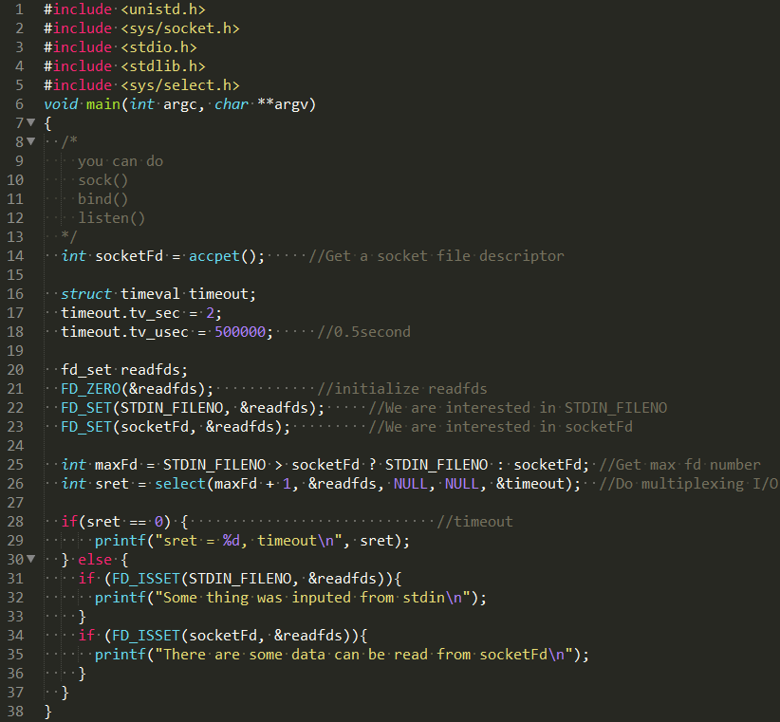
Example for select()

Slide 43
Outline
Socket
Socket API
Thread
Select()
Homework Assignment #2

Slide 44
Homework Assignments #2
Basic: Chat Room Programming with Thread (75 pts)
  Create a chat room by using TCP protocol with Thread
Advanced: (25 pts)
  Create a chat room by using TCP protocol with Select()
In this homework, you should make a application similar to chat room server/client
message

Slide 45
Thread Flowchart_Server
Start
Setup your own port:
#define MYPORT 9999
addr.sin_port=htons(MYPORT);
Establish
socket
Establish
bind
accept function will return a new socket description
Ex.
int clientsd;
clientsd=accept (…..,….,….);
You can pass the clientsd to pthread_create()
And then In the thread, you can operator send/receive to this socket
Establish
listen
Establish
accept

Slide 46
Thread Flowchart_Server (cont.)
Header:
#include <pthread.h>
Define:
int pthread_create(pthread_t* child,
pthread_attr_t* attr,
void*(*fn)(void*),
void* arg)
Thread create
send/receive
loop
Thread
exit
Socket close

Slide 47
Flowchart_Client
Start
Setup your own port:
#define MYPORT 9999
addr.sin_port=htons(MYPORT);
The same to the server side
Establish
socket
Establish
connect
send/receive
Socket
close

Slide 48
Executable Command
Format: ./server
Ex:
$ ./server
Format: ./client
ex:
$ ./client
Type message:
client1 connect
client2 connect
hello
hello
Client2:hi
hi
$ ./client
Type message:
Client1:hello
hi
Note
Please use Linux platform
Make sure that all necessary header file be included

Slide 49
Turn in
Deadline
2019/05/08 PM.11:59:59
Upload to i-learning
File name
  HW2_ID.zip (e.g. HW2_7106056035.zip)
    Source code
    Word file
If you want to update
  HW2_ID_New1.zip, HW2_ID_New2.zip….etc
If you don’t hand in your homework on time, your score will be deducted 10 points every day.

Slide 50
TA
Name: Yifen Wu(吳宜芬)
Email: emma62042@gmail.com
  Title format: TCP/IP HW# - [your name]
Lab: OSNET(1001)

Slide 51

ANY QUESTION?

